Slide 1
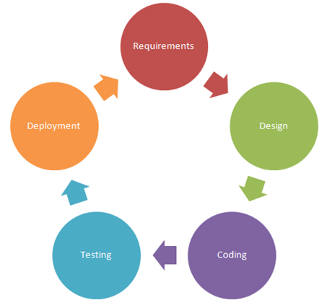


Individual Student Project
CS 3300 Individual Project

Slide 2
Portfolio Website
Each student will build a portfolio application. The portfolio will serve as a showcase of past / present projects (can be fictitious projects) the student has worked on. The portfolio will display projects to everyone but only the student can add / edit / and delete projects.

Slide 3
Customer Requirements
The portfolio shall have the ability to list an unlimited number of projects
The portfolio shall require the student to login with a username and password
The portfolio shall allow only the student to add new projects
The portfolio shall allow only the student to edit projects
The portfolio shall allow only the student to remove projects
The portfolio shall show all projects in a table on the root page
The portfolio shall allow anyone to view projects
The portfolio shall display the project’s title and full description on a separate page
The portfolio shall be responsive to mobile browsers
The portfolio shall be accessible for anywhere on the internet

Slide 4
Technical Requirements
The app’s project management must be done using GitHub
The app’s source code must live in GitHub
The SaaS app must be developed using Ruby on Rails
The app must utilize TravisCI for continuous integration and delivery
The app must utilize Heroku for hosting
The app must have at least 3 projects for testing and grading in production
The app must have 80% code coverage as measured by Simplecov
10 points extra credit if the CI pipeline runs Simplecov
The app must utilize Bootstrap for the front-end framework

